Slide 1
2k-Cycle Free Bipartite Graph
Steven Wu

Slide 2
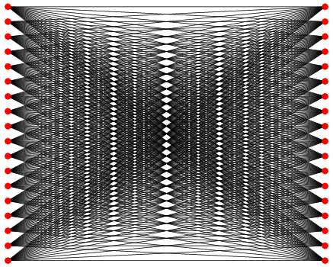
What is a bipartite graph?

Slide 3
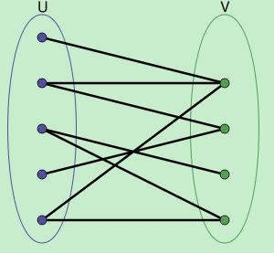
Any graph with no odd cycles is bipartite
Definition: A bipartite graph (or bigraph) is a graph whose vertices can be divided into two disjoint sets U and V such that every edge has one endpoint in U to the other in V.

Slide 4
There are only 2k-cycles in a bipartite graph.
In a simple undirected graph, the shortest length of a cycle is at least 4.
The bound of the number of 2k-cycles in a bipartite graph is closely related to
projective planes.

Slide 5
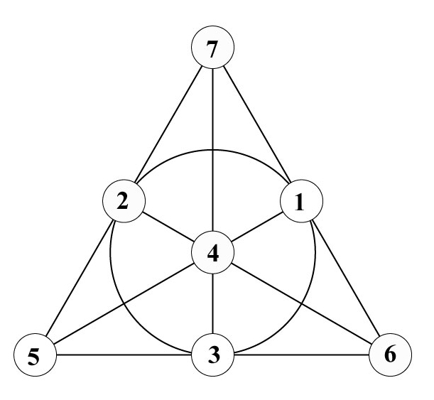
Combinatorial Projective Planes
Three properties:
1. Given any two distinct points, there is exactly one line incident with both of them.

Slide 6
2. Given any two distinct lines, there is exactly one point incident with both of them.
3. There are four points such that no line is incident with more than two of them.

Slide 7
For n = q^2+q+1, let π be the projective plane of order q with
point set P={p1, p2 … pn}and line set L={l1, l2 … ln}.
In the case of Fano plane,
q=2, and there are 7 points and 7 lines.

Slide 8
The Levi Graph
The Levi graph G(π) of a plane π is its point-line bipartite incidence graph.
G(π) = G(P, L; E)
where x,y forms an edge in the graph if and only if the poiont x is on the line y.

Slide 9
1 2 3 4 5 6 7
A B C D E F G
The Levi graph is 3-regular and 4-cycle free.
Notes:
Steven @ DIMACS

Slide 10
The Levi Graph of any projective plane is 4-cycle free.
The number of edges of Levi Graph can also give us the bounds for edges for 6- and 8-cycle free bipartite graphs.

Slide 11
The Levi Graph of any projective plane is 4-cycle free.
The number of edges of Levi Graph can also give us the bounds for edges for 6- and 8-cycle free bipartite graphs.

Slide 12
Open Problems to work on
The bound of 2k-cycles under different variations.
For example: a bipartite graph with girth 4 but has 6-cycles.
A bipartite graph with partitions of different cardinalities…

Slide 13
Thanks.

